Slide 1
Gulf of Maine Calanus vertical distribution

Slide 2
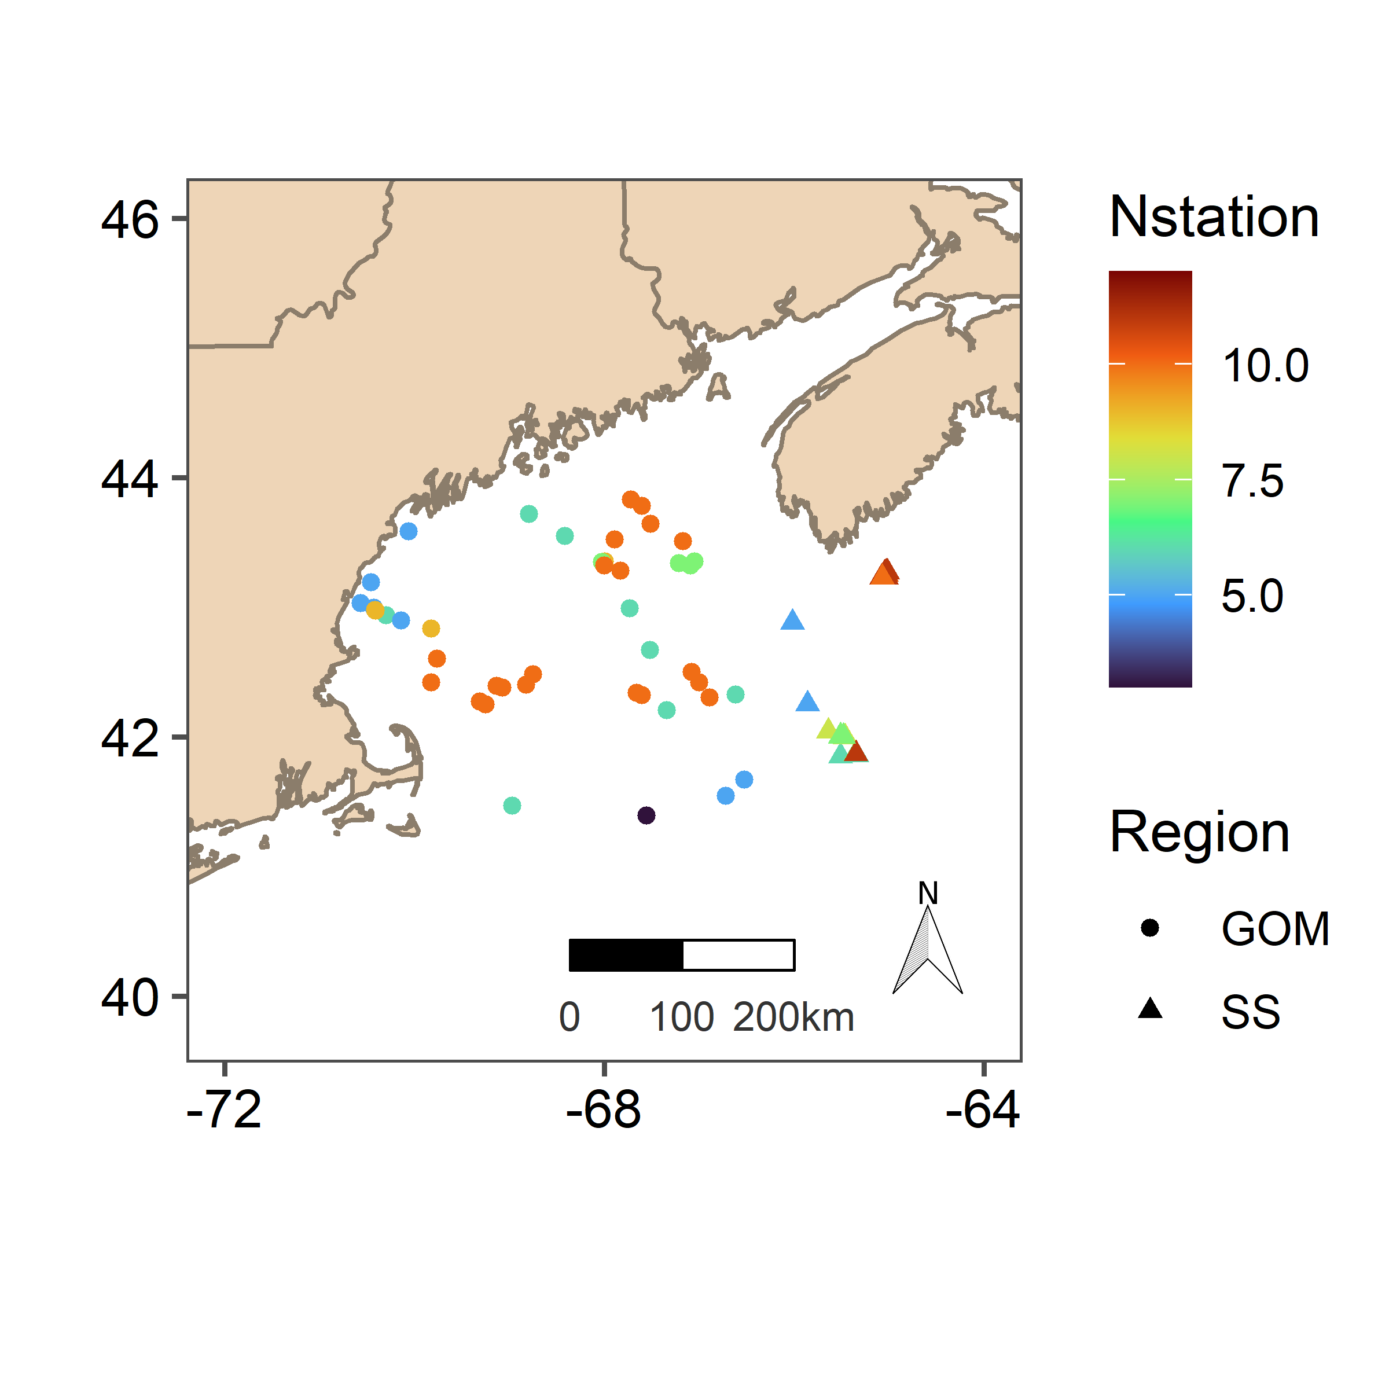
C. Fin CIV-CVI vertical distribution
0-abundance are removed and not shown
Stations on the scotian shelf
for stations deeper than 200m to provide stability in prediction
more Cglac and Chyp stations

Slide 3
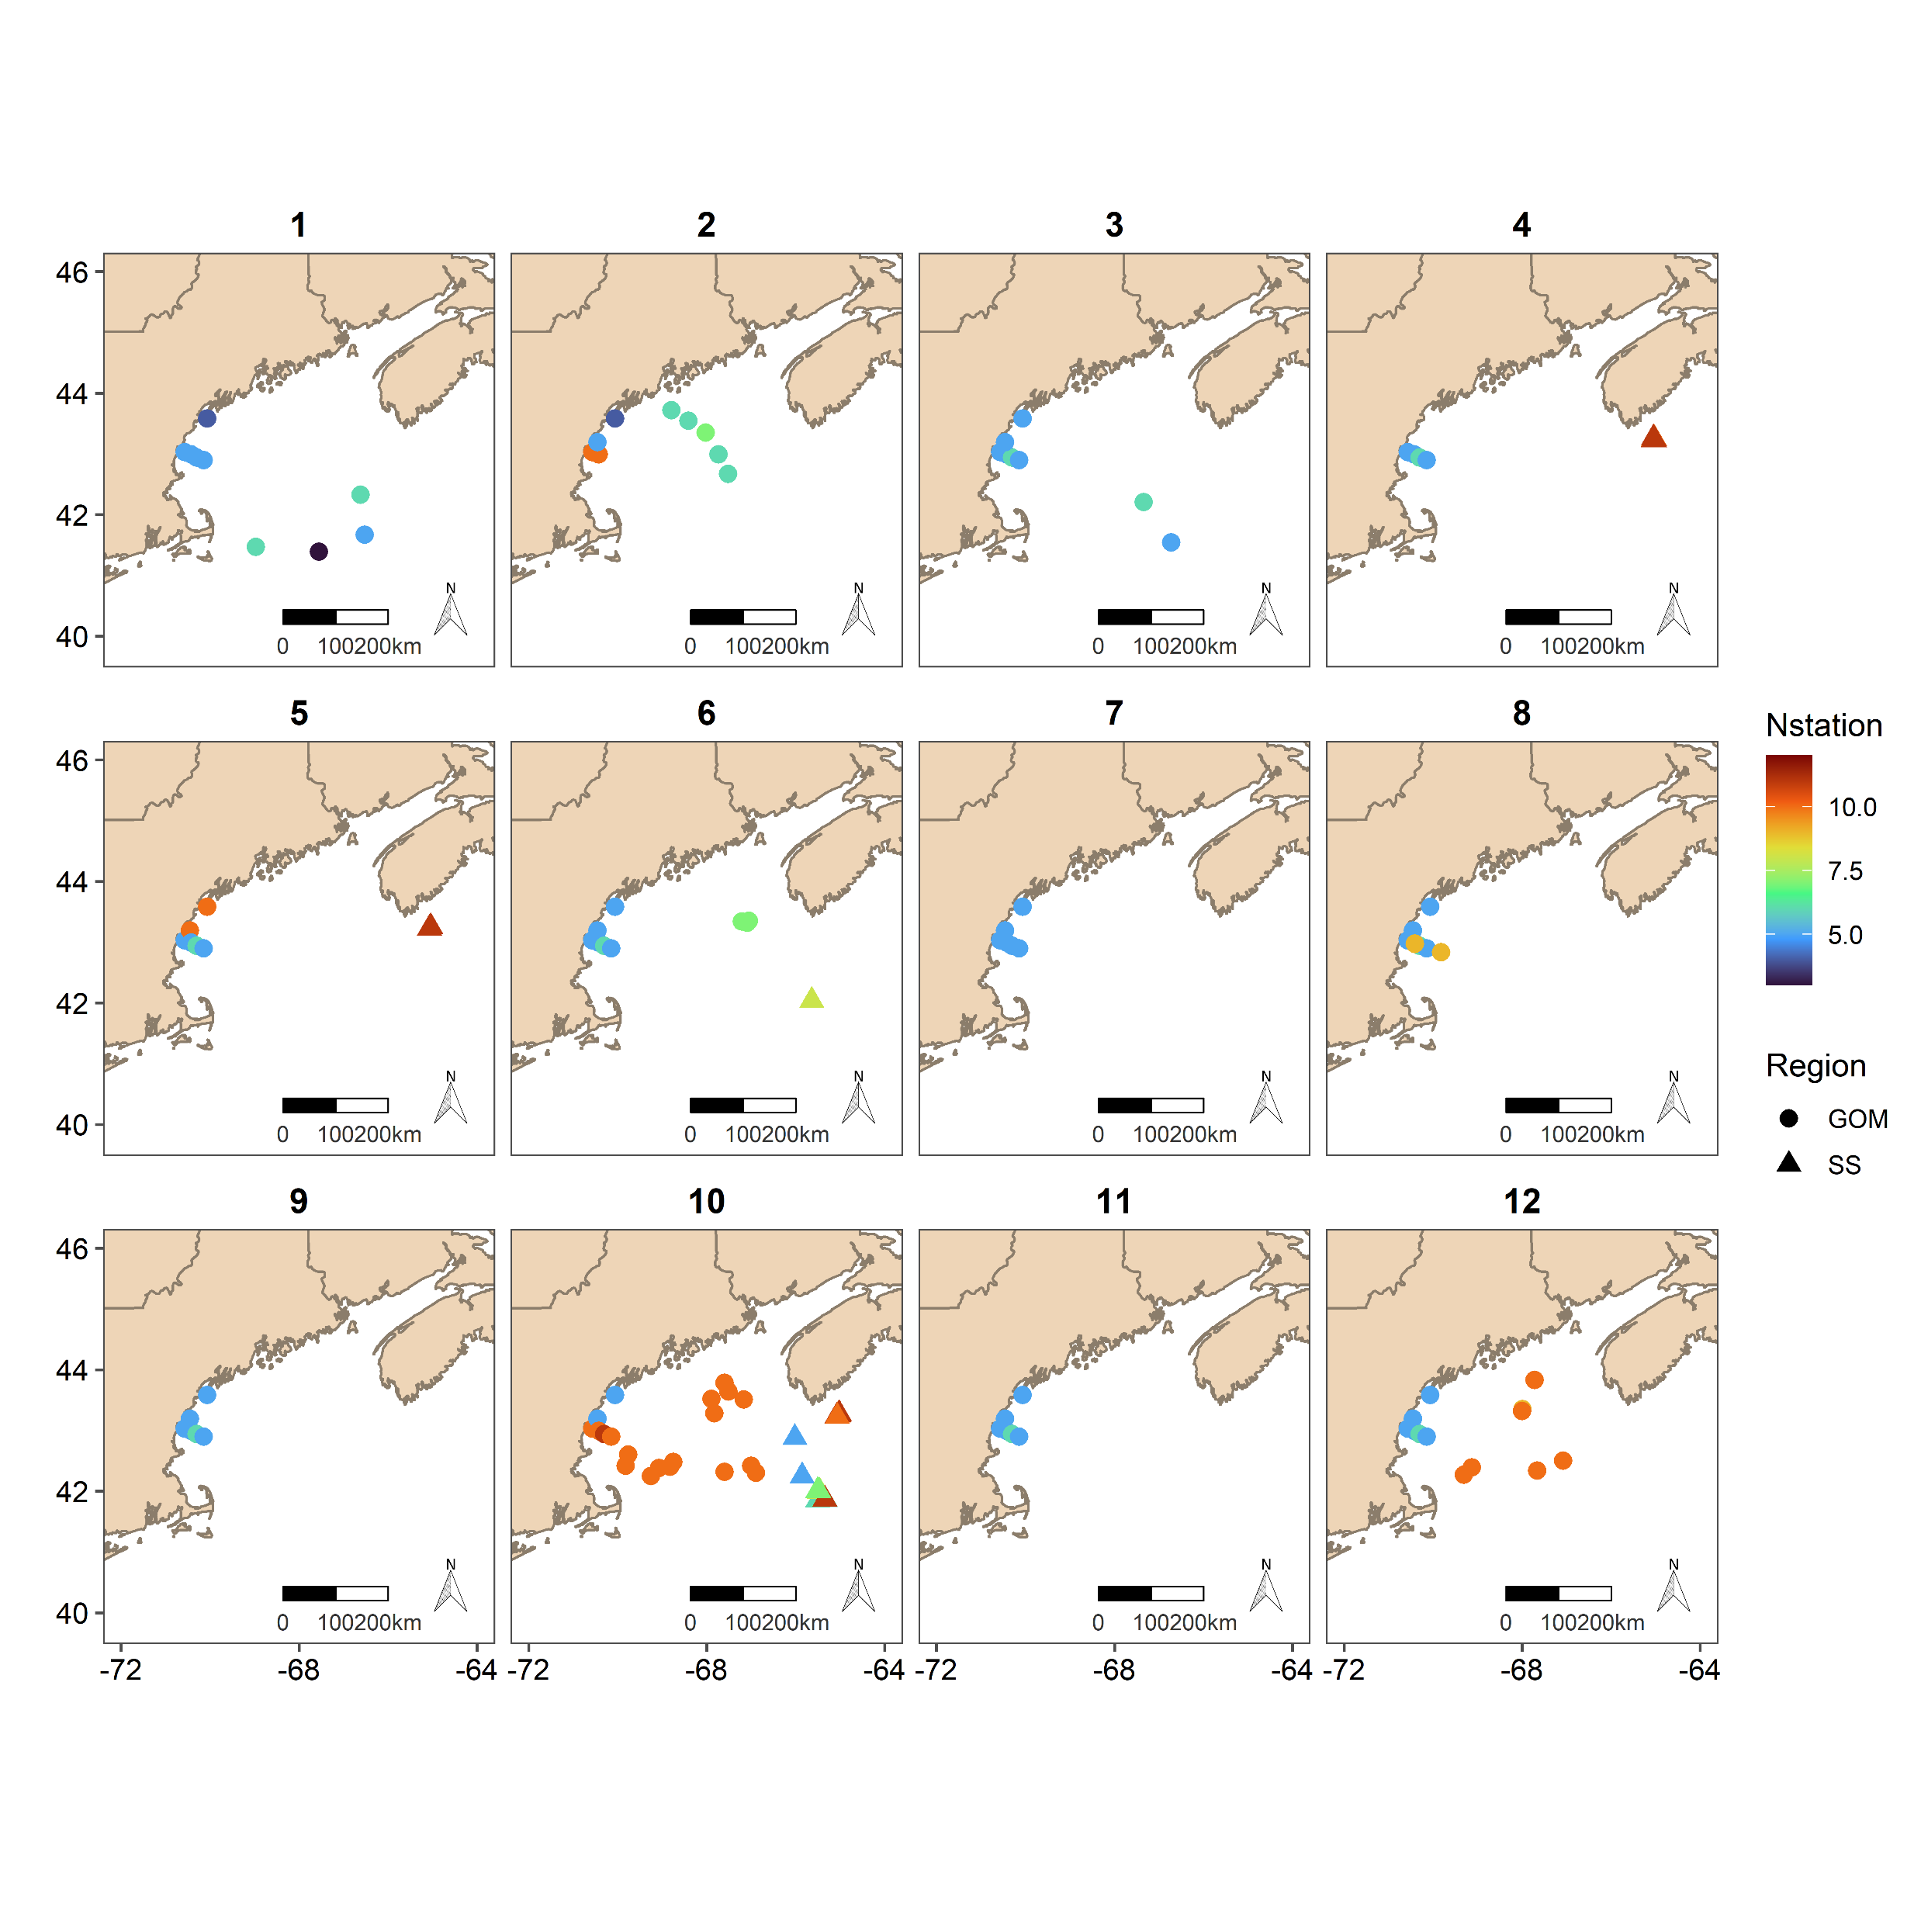
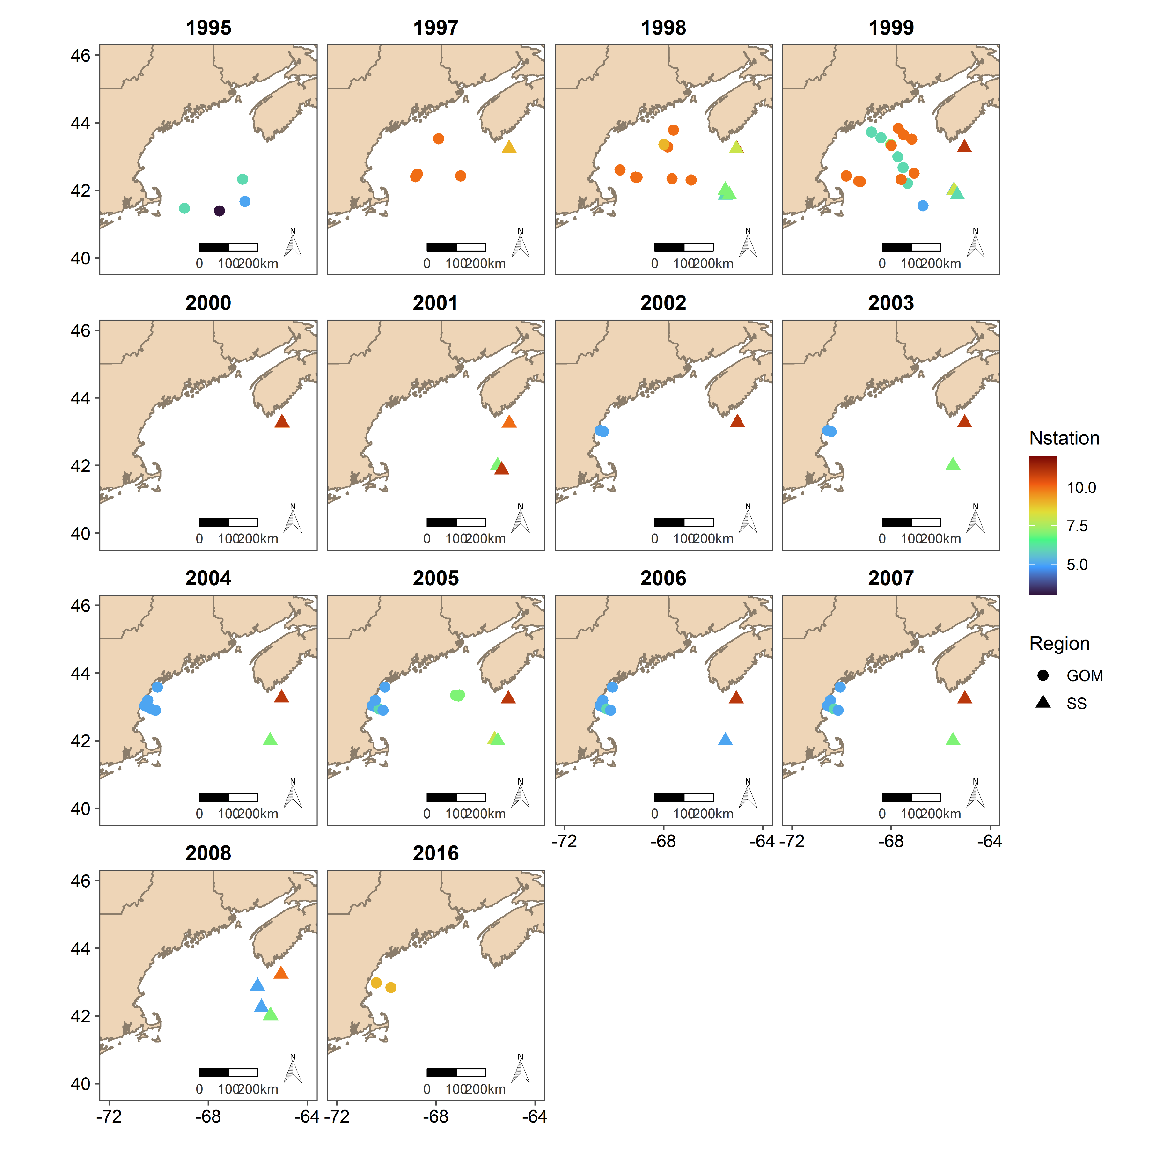

Slide 4
Example:1 station with a unique ID
Response variable
Indepedent variables
Zmin | Zmax | Z | %Z | Ind/m2 | Cumind/m2 | pcum
0 | 20 | 68 | 29 | 10 | 10 | 0,21
20 | 40 | 68 | 59 | 10 | 20 | 0,42
40 | 60 | 68 | 88 | 20 | 40 | 0,83
60 | 68 | 68 | 100 | 8 | 48 | 1
Estimated based on the assumption that it is the same density as in the previous layer

Slide 5
Equations
Beta distribution (between 0 and 1)
pcum~ ti(%Z x fMonth) + ti(log Z x fMonth) + ti(%Z x logZ x fMonth) + s(ID, bs="re")
Where Month is a factor and ID (unique sampling event) is a random effect
pcum~ te(%Z x Z x Month) + s(ID, bs="re")
Where Month is continuous
pcum~ ti(%Z x Season) + ti(log Z x Season) + ti(%Z x logZ x Season) + s(ID, bs="re")
Where season are diapause and active (similar to Sorochan et al. 2019)
March-June considered active months same as Sorochan
Notes:
ID is a unique sampling event included as a random effect to account for the non independance of the data

Slide 6
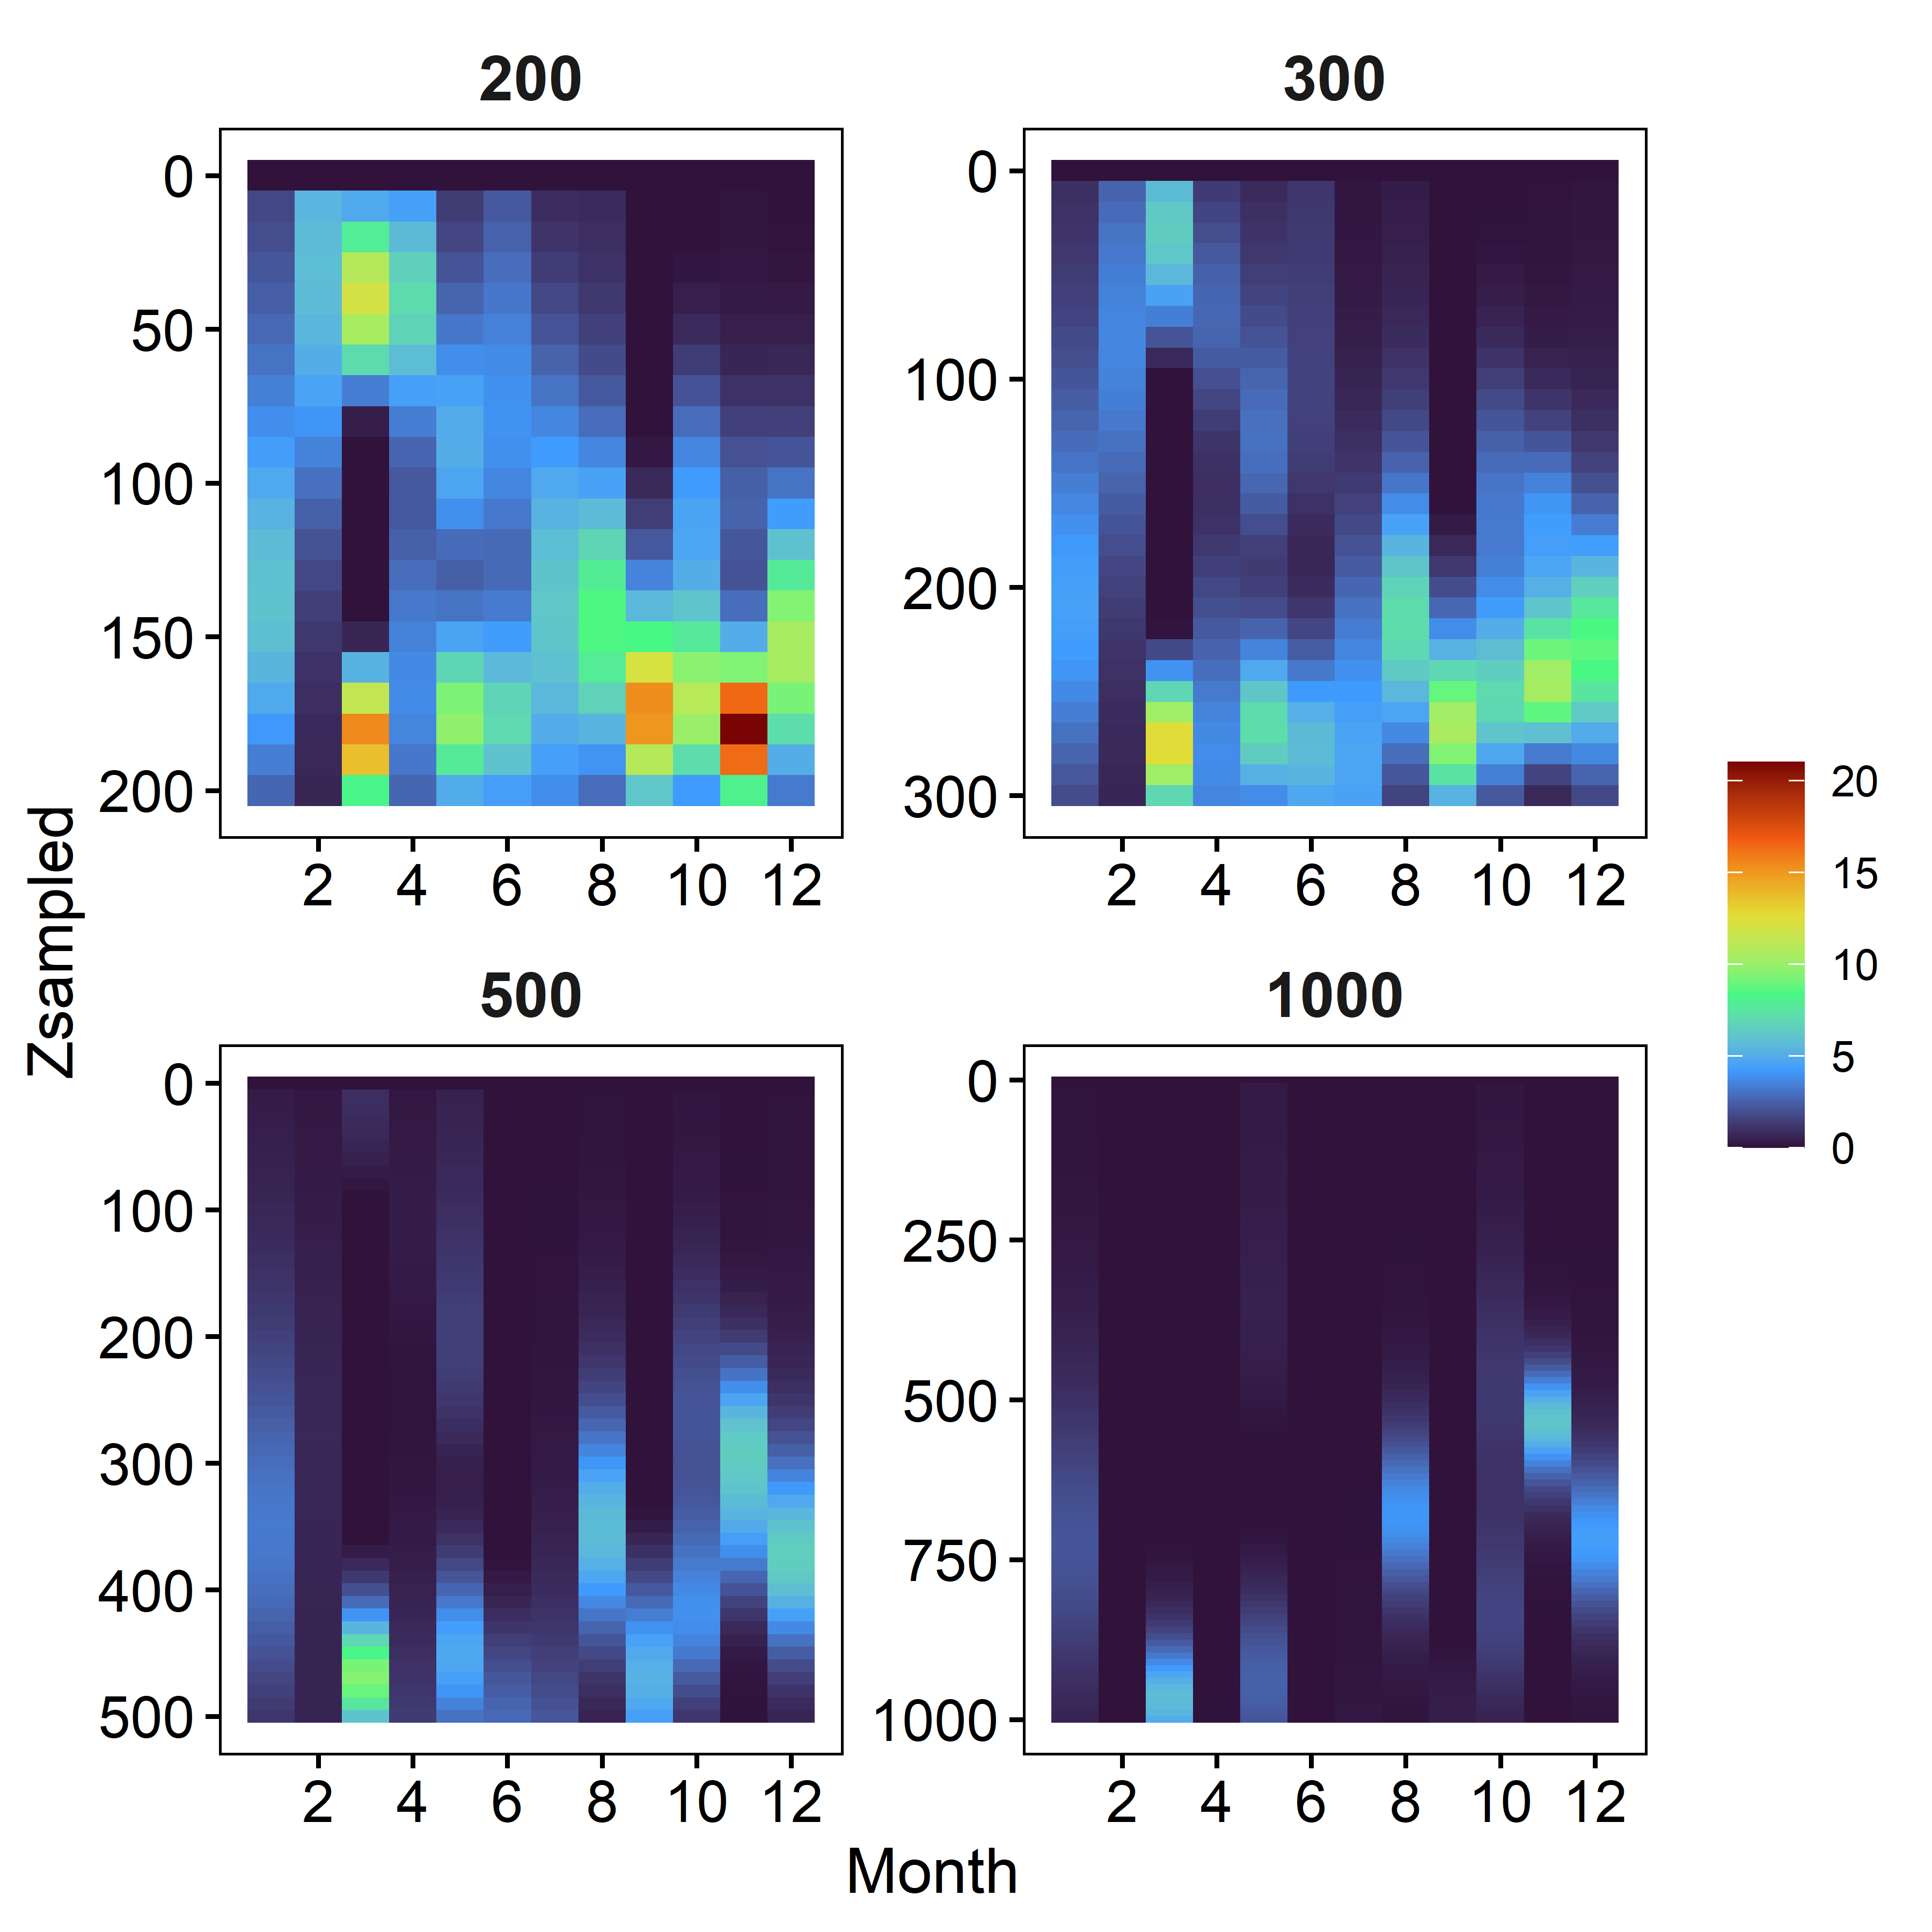
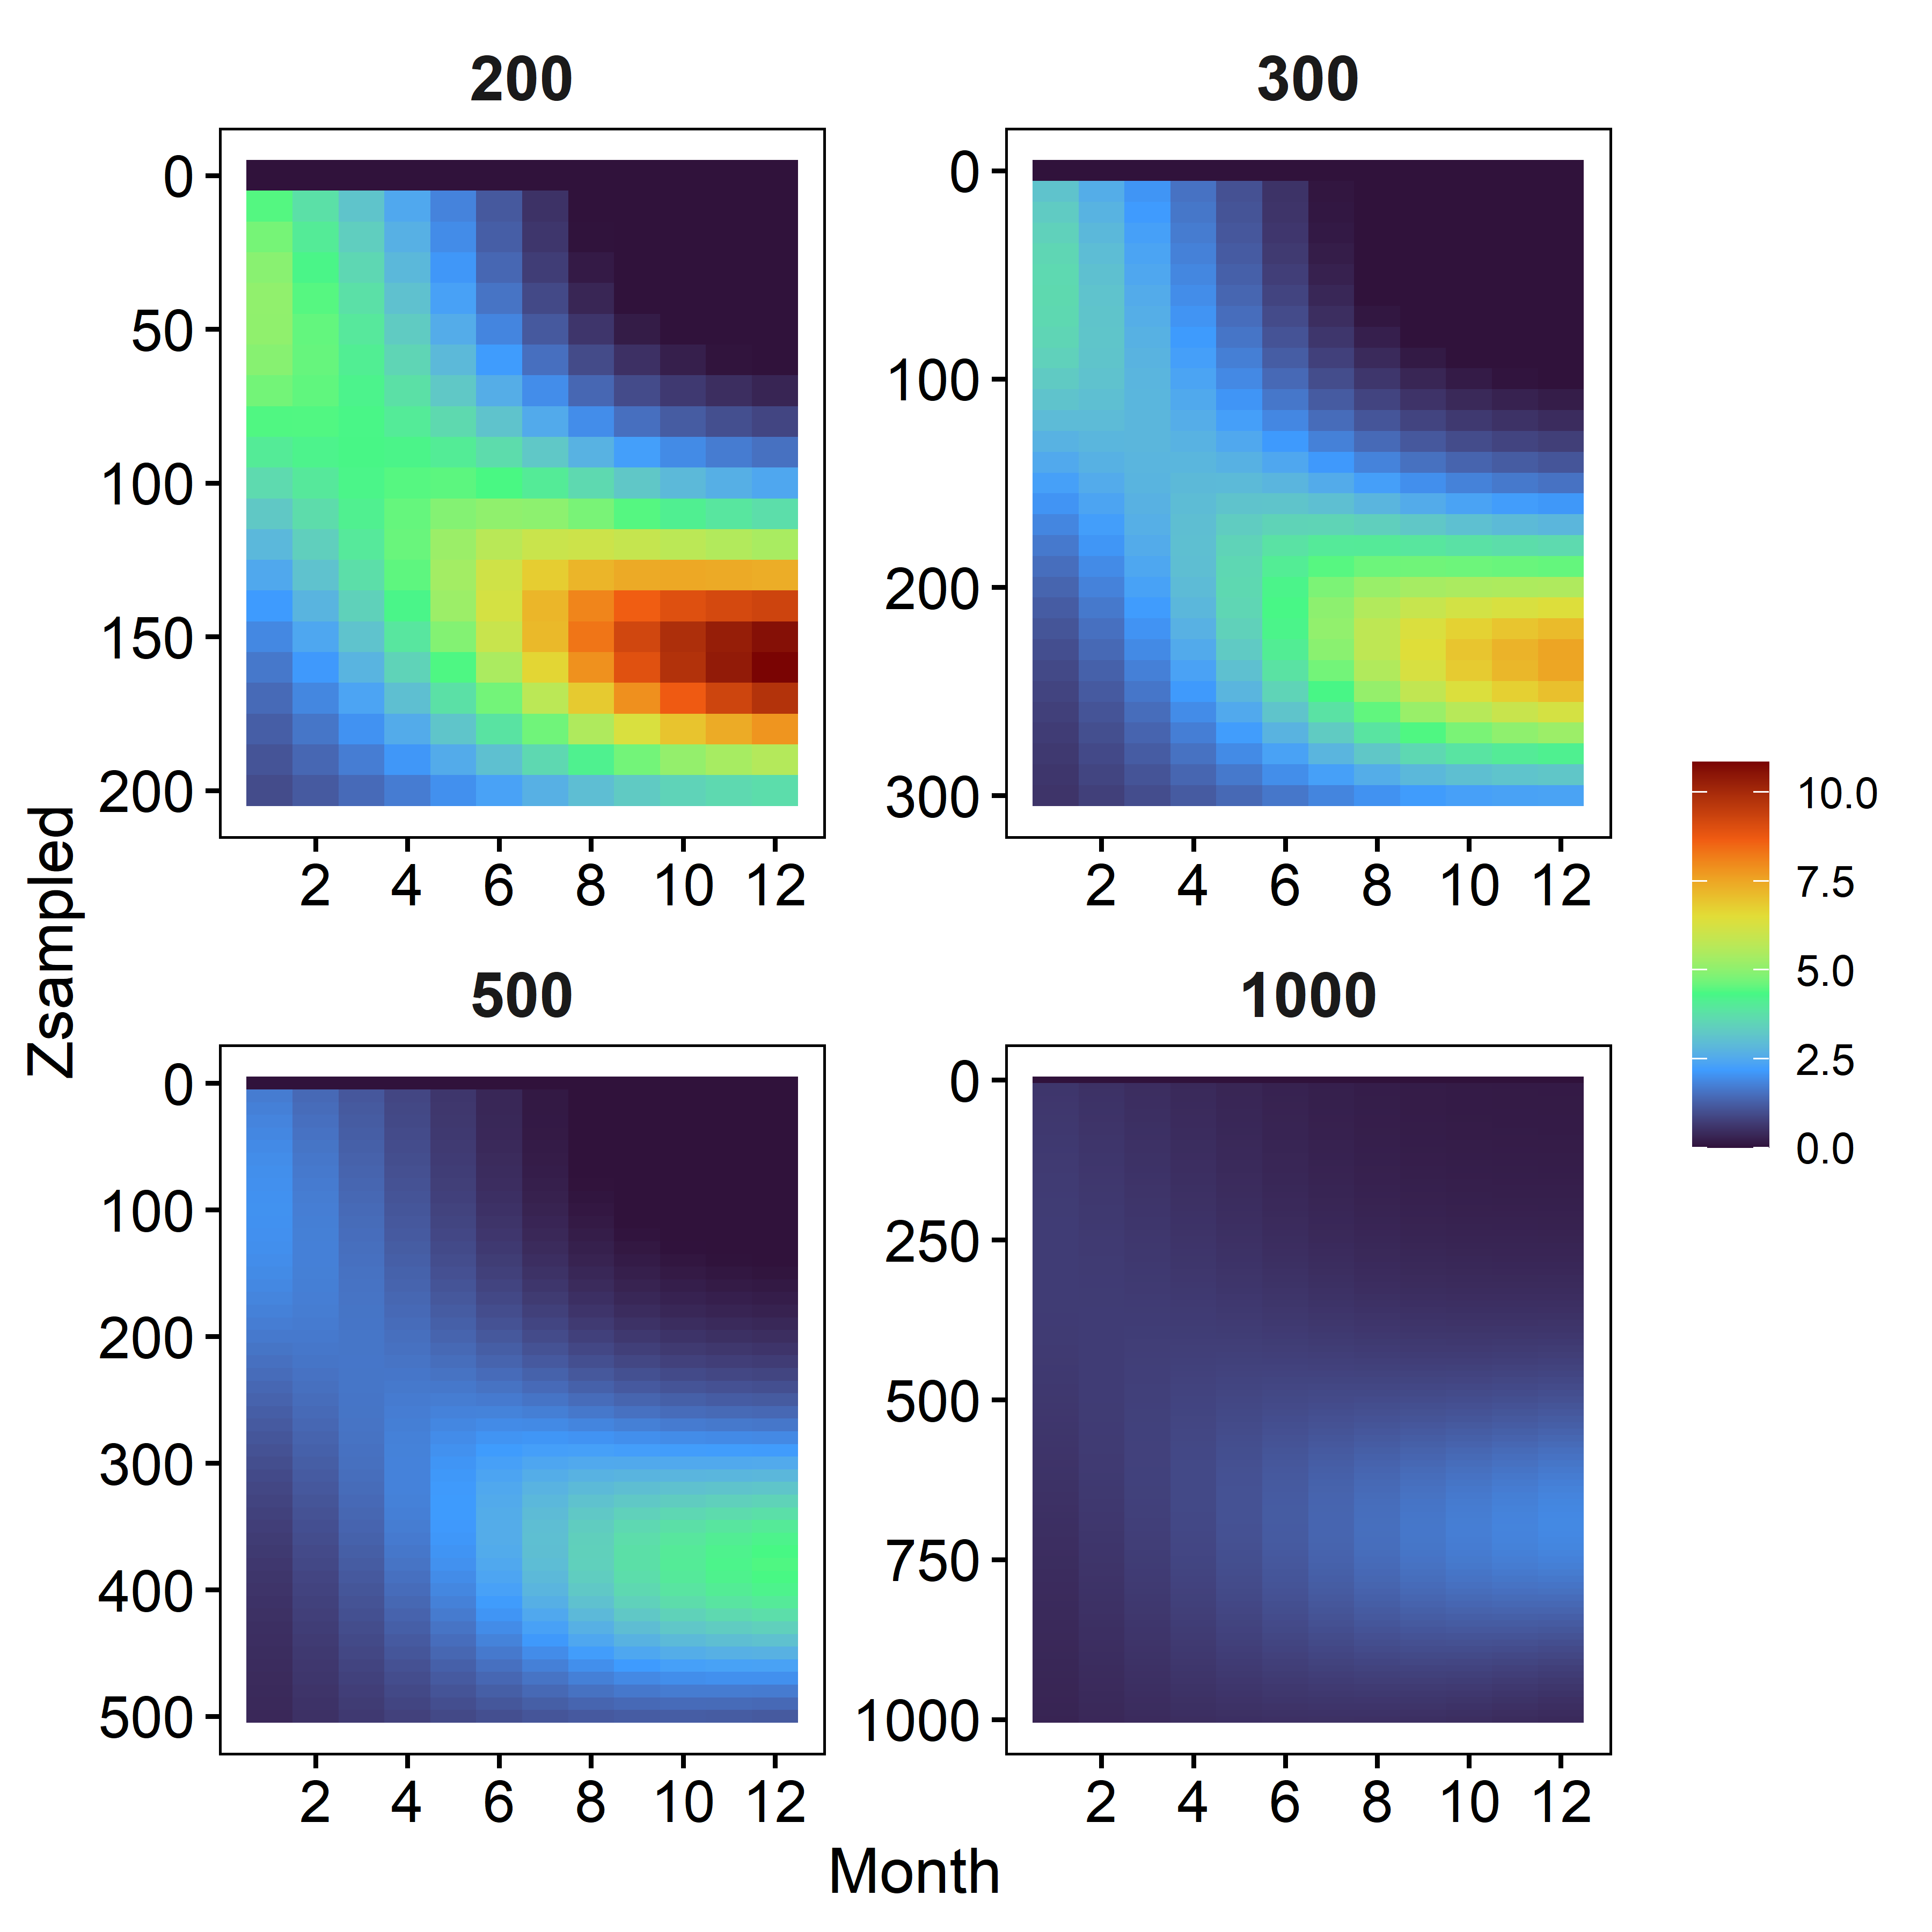
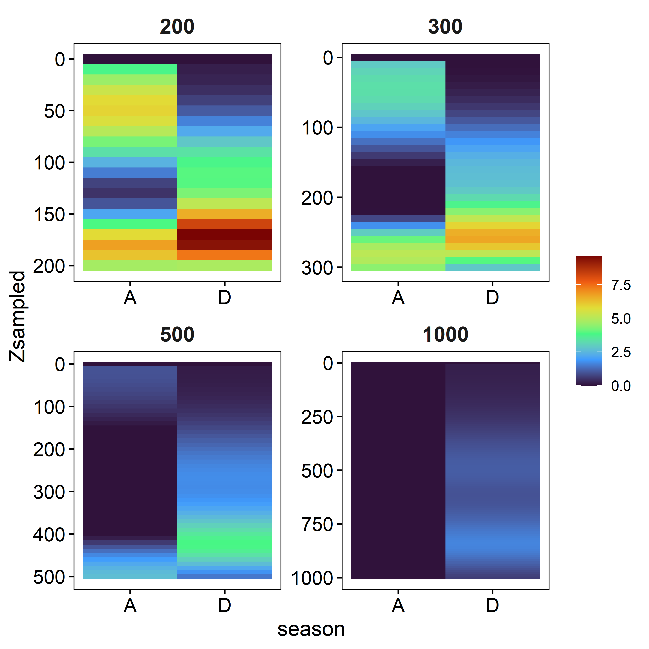
Model 1: Month as factor
Model 2: Month as continuous
Model 3: Season
Notes:
See details on colorscale on the last slide

Slide 7
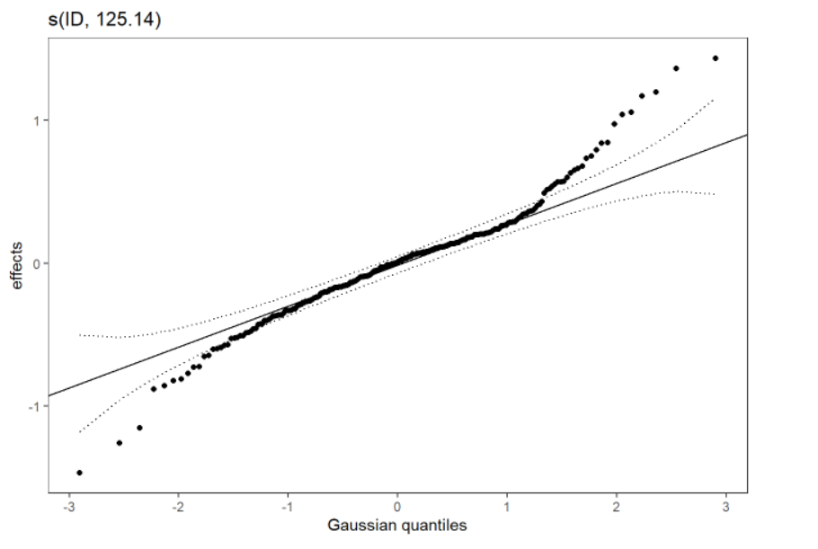
Model 1: Month as factor
Model 2: Month as continuous
Model 3: Season
Notes:
Model 2 is removed because the assumption of normality for the random effects is not met. Other 2 models are OK

Slide 8
Model 1: Month as factor
Model 2: Month as continuous
Model 3: Season
Notes:
Model2 is not considered further since assumption is not met

Slide 9
Which one is better? Simulation
Replace in equation: Z =400m %Z= 50%
Predict pcum= 0.33
100/0.33 = 300 ind/m² for the whole water column
Perfect prediction Yeah!
100 ind/m²
EcoMon –like data
200m
200 ind/m²
Predict this with each GAMM
Notes:
I used the depth-stratified data from Kira’s paper and simulated the same correction than the EcoMon data. I virtually sampled only the first 200 m and predicted with the GAMMs what’s under 200m. I then compared with the sample on next slide

Slide 10
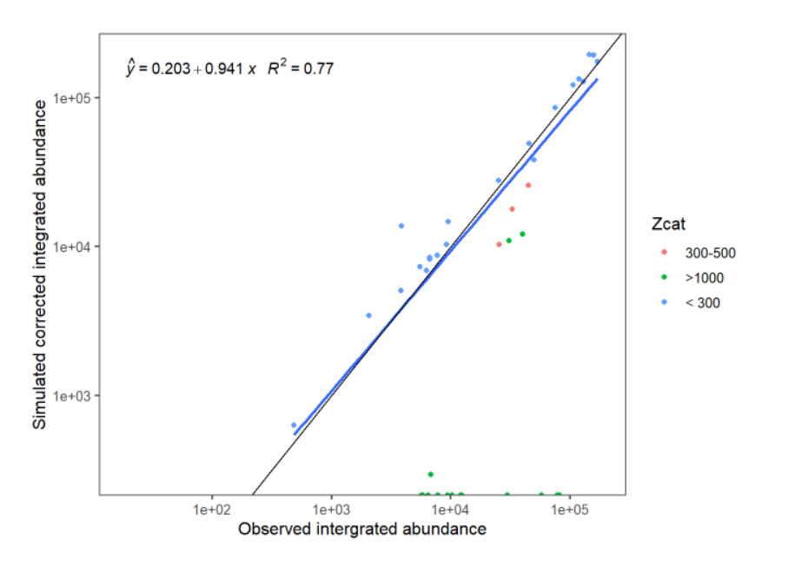
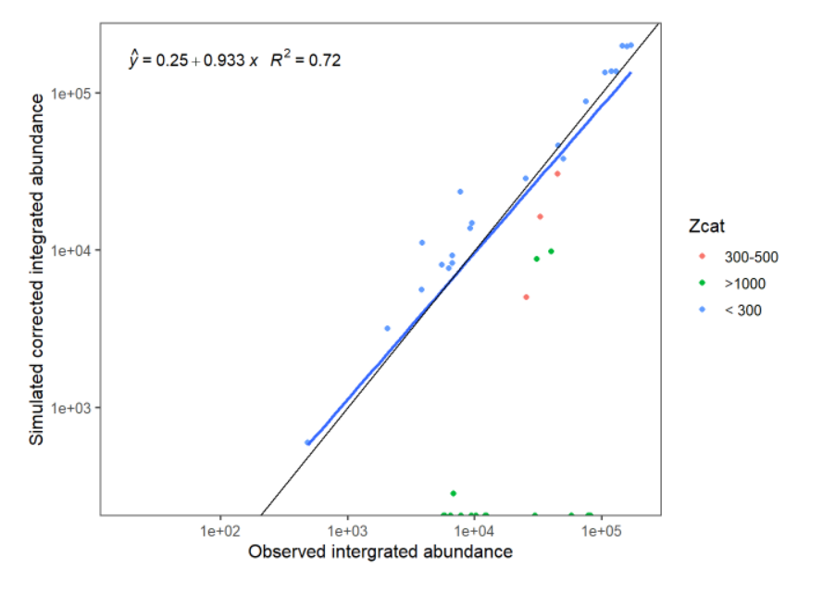
Which one is better: Simulation
No big difference, Model 1 is a bit better
Model 1: Month as factor
Model 3: Season
AIC= - 4480
AIC= - 4329
Notes:
The models do a good job particularly for stations < 300m and a OK job for station 300-500m . Model 1 is slightly better and the AIC is also smaller.

Slide 11
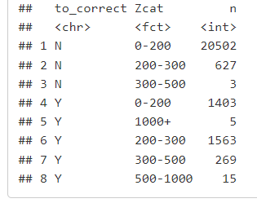
Which one is better: Simulation
No big difference, Model 1 is a bit better
Model 1: Month as factor
AIC= - 4480
AIC= - 4329
Are we worried about that?
In the EcoMon dataset : Only 20 stations have a depth >500 m and of that only 5 >1000 m
Notes:
The >1000m are not sampled accuratly if only 200m are sampled. REMOVE THEM from the ExoMon dataset. We are not sure about the 500-1000m data because there were none in my dataset. Suggest to remove them also since they are not a lot of them.

Slide 12
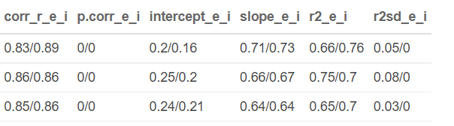
Which one is better: Cross-validation
4-fold cross-validation 30% put aside for validation
Proportion of Month or season is preserved in the validation dataset
First-value e stands for external (cross-validation), i stands for internal (100% for fitting and calibration).
Spearman’s correlation coefficient
Linear regression between observations and predictions
Model 1 Month factor
Model 2 Month cont.
Model 3 Season
Notes:
Again model 1 slighlty better slope is closer to 1.

Slide 13
Cfin CV-CVI
Model 1: Month as factor
Model 2: Month as continuous
Model 3: Season
Residual patterns against Month, Year, Longitude and Zstation are all OK
Notes:
How is that calculated.
Create a matrix of 10m depth increments for each station depth and Month. Predict with the GAM (while removing the random effect) which will predict a proportion of abundance from 0 to 1 from top to bottom. Make the difference between each layer and the layer just above to move from cumulated to the actual proportion of abundance in each depth layer. Colorscale is the proportion of abundance in a 10-m layer. First one is always 0 as there is no above layer to substract from.
This is CV-CVI, see next slide for CIV-CVI

Slide 14
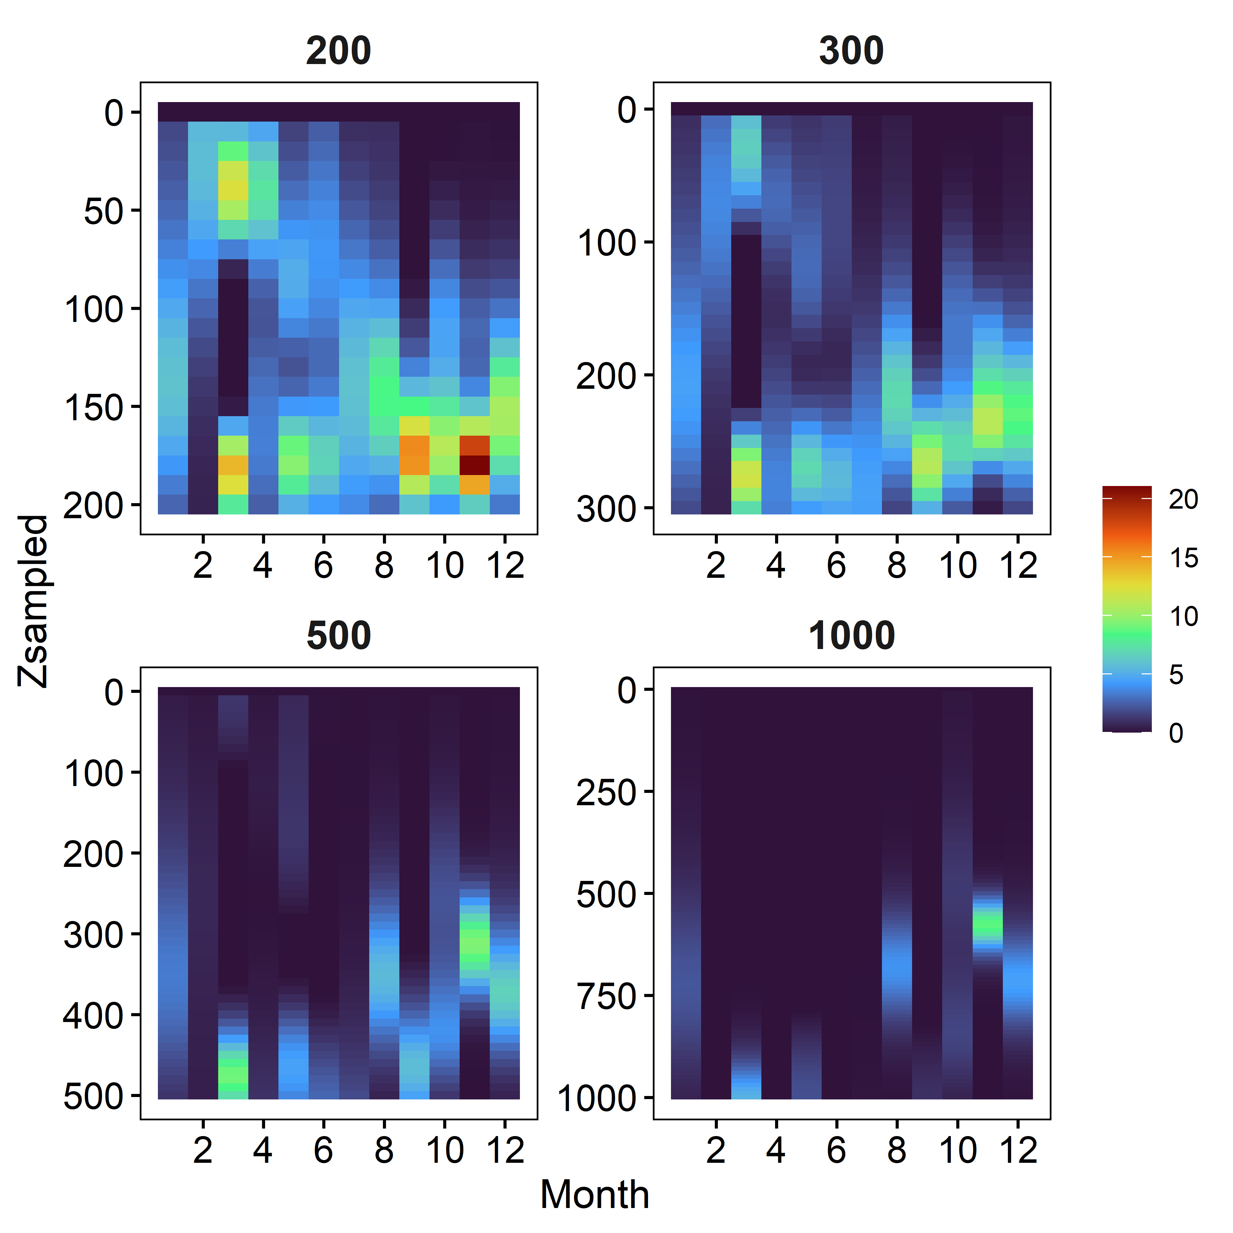
Cfin CIV-CVI
Model 1 : Month as factor
Residual patterns against Month, Year, Longitude and Zstation are all OK

Slide 15
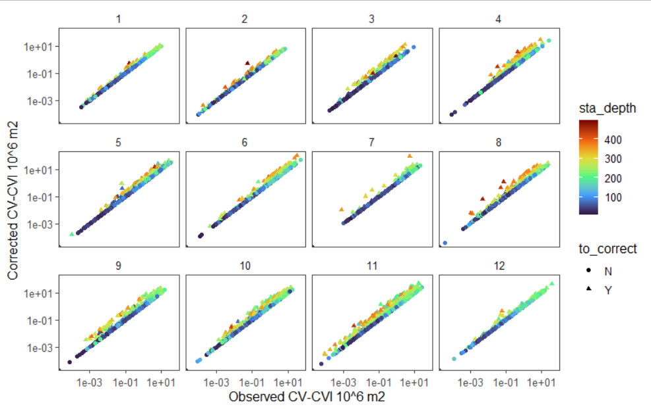
CV-CVI corrections
Notes:
How I did this figure is included in R code how_to_correct_ecomon_data

